Slide 1
Aymane Hinane
Développement d’une application de gestion de vente de produits

Slide 2
Presentation Du Plan
Creation de La BD
Gestion de l’etat de connexion
Gestion de l’authentification
Creation des datatable dans le dataSet
Recuperer les donnees
Ajouter des donnees
Filtrer les donnees
Modifier les donnees
Passer une commande et creer une facture (Stored Procedure & Trigger)

Slide 3
Creation de la BD

Slide 4
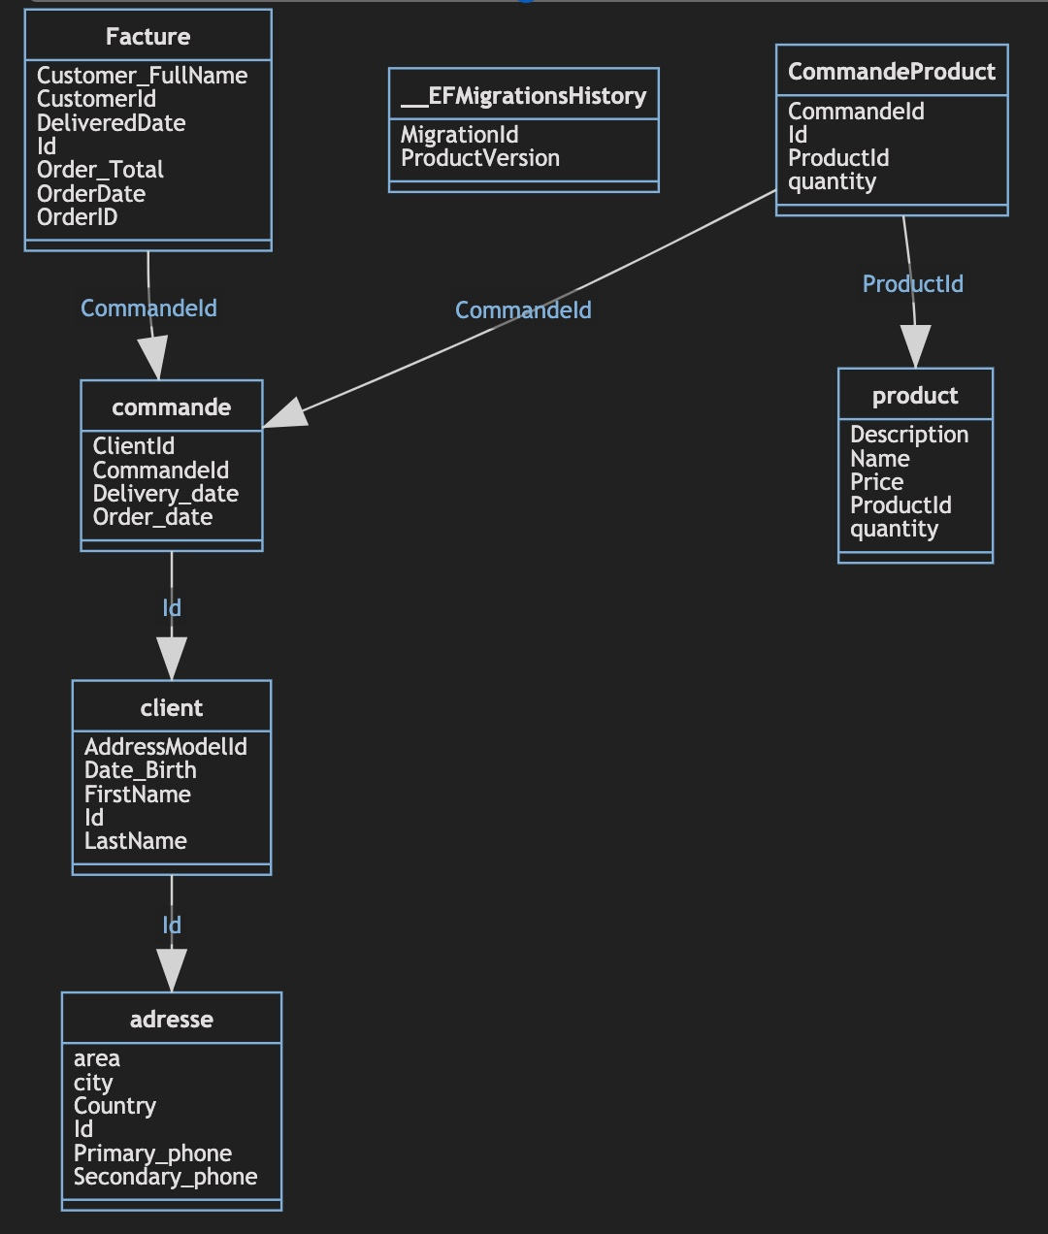
UML Diagram De Class

Slide 5
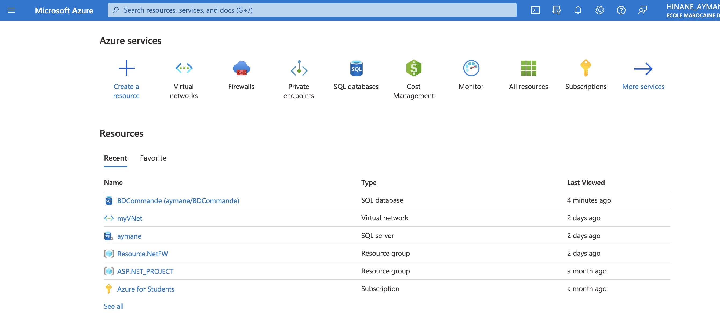

Slide 6
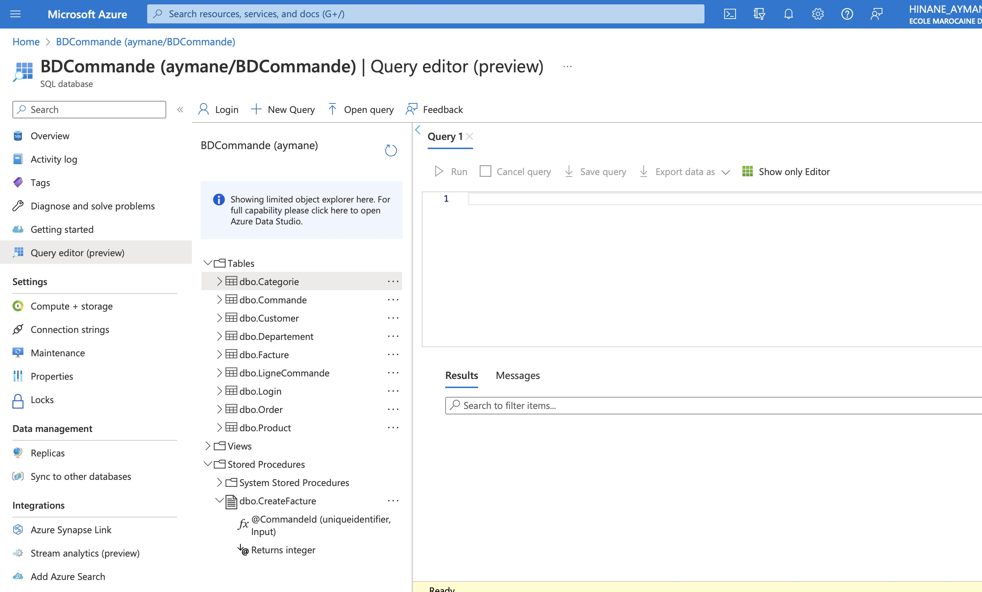

Slide 7
DBContext

Slide 8
Gestion de l’etat de connexion
public class DbContext
{
private readonly string connetionString =
@"Server=tcp:aymane.database.windows.net,1433;Initial Catalog=BDCommande;Persist Security Info=False;
UserID=aymane;Password=One1ForAll.;MultipleActiveResultSets=False;Encrypt=True;TrustServerCertificate=False;
Connection Timeout=30;";
private SqlConnection connection;
public DbContext()
{
connection = new SqlConnection(connetionString);
}
public void OpenConnection()
{
connection.Open();
}
public void CloseConnection()
{
connection.Close();
}

Slide 9
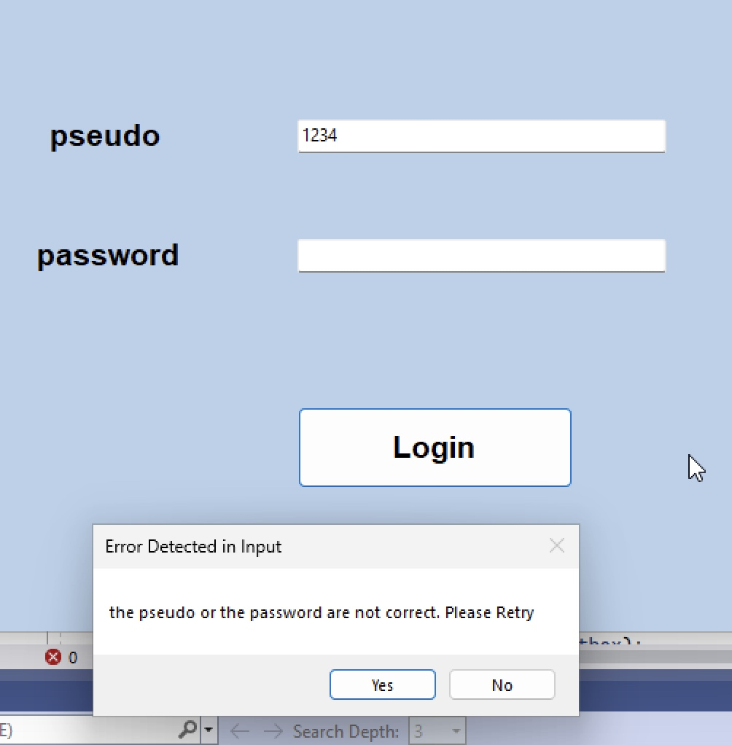
Aunthentification
public bool Login(string pseudo, string password)
{
DataSet = new DataSet("DBCommand");
DataTable Login = new DataTable("Login");
Login.Columns.Add("Id", typeof(Guid));
Login.Columns.Add("Pseudo", typeof(string));
Login.Columns.Add("Password", typeof(string));
DataSet.Tables.Add(Login);
this.OpenConnection();
dataAdapter = new SqlDataAdapter($"select * from Login
where Pseudo='{pseudo}' and Password='{password}'", connection);
dataAdapter.Fill(DataSet, "Login");
this.CloseConnection();
DataView dv = new DataView(DataSet.Tables["Login"]);
if (dv.Count > 0)
{
AddTableToDataSetGenerique();
return true;
}
return false;

Slide 10
Create DataTable
public void AddTableToDataSetGenerique()
{
DataTable Customer = new DataTable("Customer");
Customer.Columns.Add("Id", typeof(Guid));
Customer.Columns.Add("FirstName", typeof(string));
Customer.Columns.Add("LastName", typeof(string));
Customer.Columns.Add("Adresse", typeof(string));
Customer.Columns.Add("NumTelephone", typeof(string));
Customer.Columns.Add("DateNaissance", typeof(DateTime));
#
#
#
DataSet.Tables.Add(Customer);
#
#
}

Slide 11
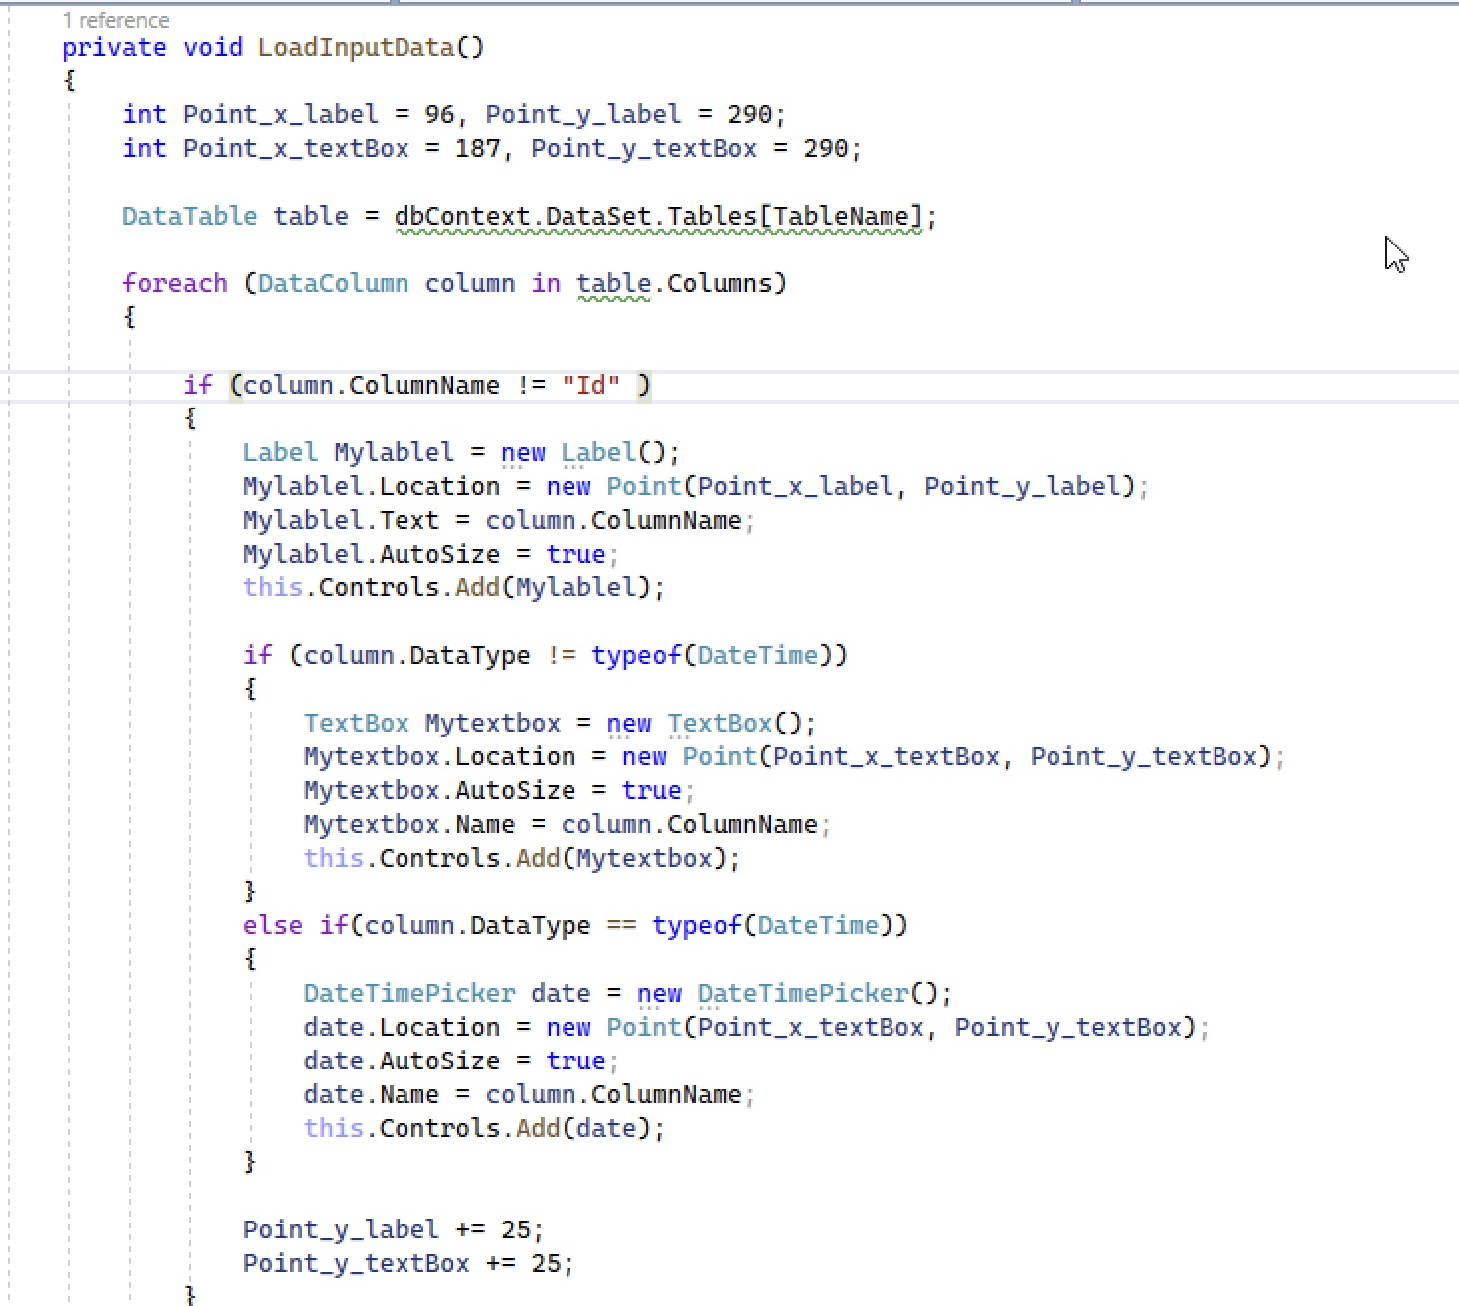
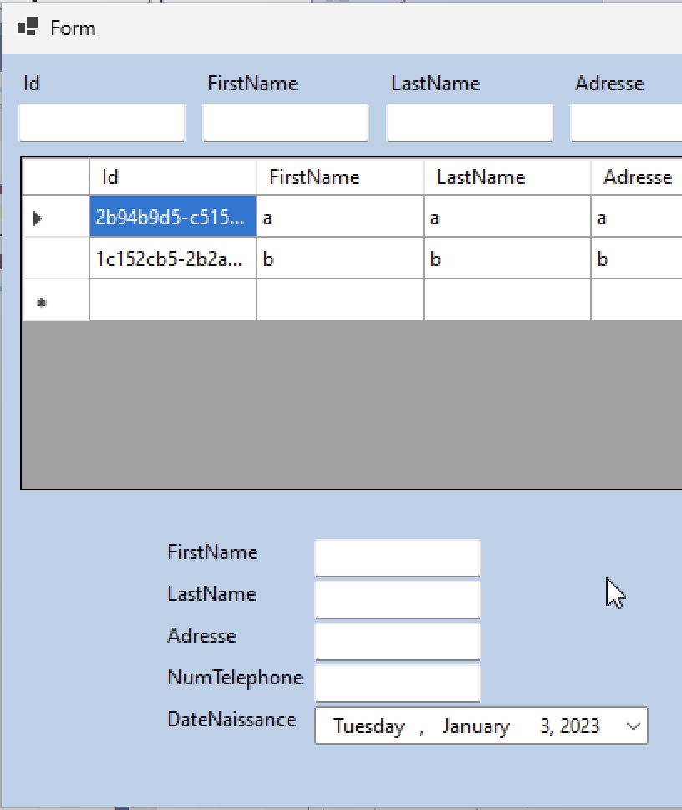
Generate Formulare

Slide 12
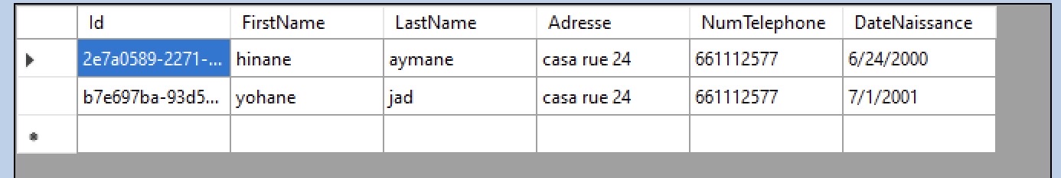
Recuperer la Donnees
public void GetDataGenerique(string tableName)
{
this.OpenConnection();
DataSet.Tables[tableName].Clear();
string request = $"select * from {tableName}";
dataAdapter = new
SqlDataAdapter(request,connection);
dataAdapter.Fill(DataSet, tableName);
this.CloseConnection();
}
private void ManagementForm_Load(object sender, EventArgs e)
{
dbContext.GetDataGenerique(TableName);
this.dataGridView.DataSource =
dbContext.DataSet.Tables[TableName];
if (TableName != "Facture")
{
LoadInputData();
LoadInputFilter();
}
}

Slide 13
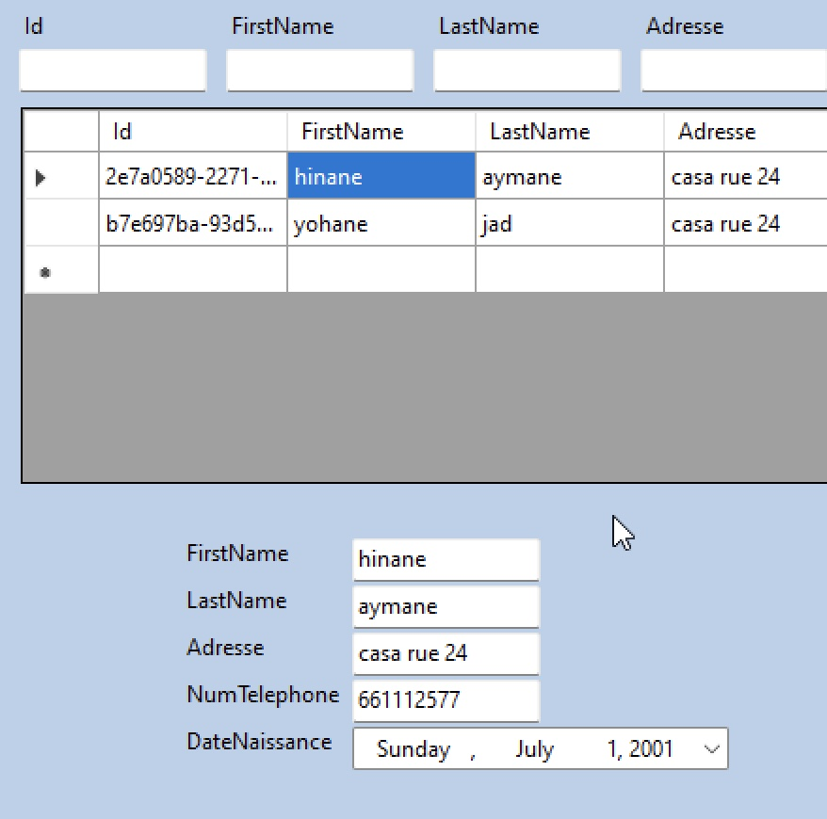
Ajouter Les Donnees
public void AddDataGenerique(string tableName,Dictionary<string, Object> newData)
{
this.OpenConnection();
SqlDataAdapter da = new SqlDataAdapter();
string sql4 = @$"INSERT INTO {tableName} VALUES(NEWID()";
foreach (KeyValuePair<string, Object> entry in newData)
{
if (entry.Value is int || entry.Value is decimal)
sql4 += $@",{entry.Value}";
else
sql4 += $@",'{entry.Value}’”;
}
sql4 += $");”;
da.InsertCommand = new SqlCommand(sql4, connection);
da.InsertCommand.ExecuteNonQuery();
this.CloseConnection();
}

Slide 14
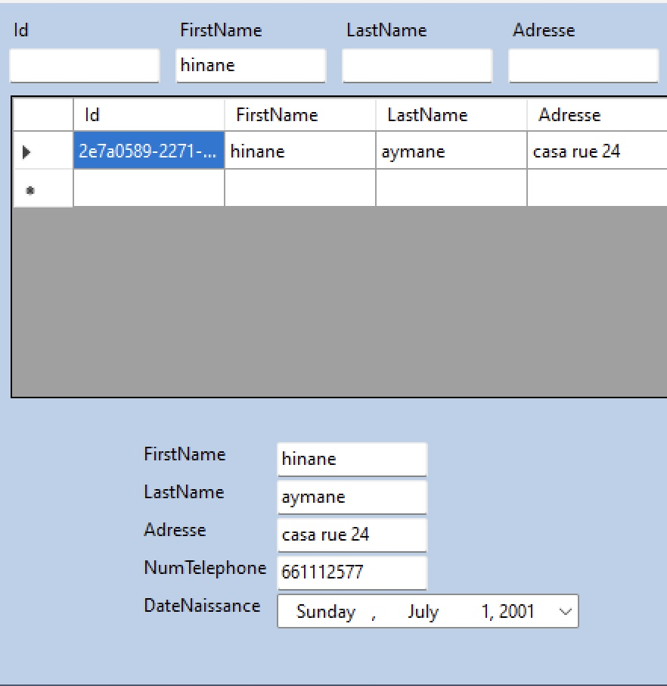
Filtrer les Donnes

Slide 15
CREATE PROCEDURE dbo.CreateFacture
@CommandeId UNIQUEIDENTIFIER
AS
BEGIN
DECLARE @CustomerId UNIQUEIDENTIFIER;
DECLARE @Customer_FullName NVARCHAR(60);
DECLARE @OrderDate DATETIME;
DECLARE @Order_Total DECIMAL(18,0);
if (Exists(select * from LigneCommande where CommandeId = @CommandeId) and
Exists(select * from Commande where Id = @CommandeId))
BEGIN
SELECT @CustomerId=cu.Id,@Customer_FullName=cu.FirstName+''+cu.LastName,@OrderDate=co.OrderDate,@Order_Total=SUM(li.Quantity*p.Price)
from Customer as cu
INNER join Commande as co on cu.Id = co.CustomerId
INNER join LigneCommande as li on co.Id = li.CommandeId
INNER join Product as p on p.Id = li.ProductId
where co.Id = @CommandeId
GROUP by cu.Id,cu.FirstName,cu.LastName,co.Id,co.OrderDate,co.Id;
insert into Facture VALUES(NEWID(),@CustomerId,@Customer_FullName,@OrderDate,GETDATE(),@Order_Total,@CommandeId);
update Commande set Status = 'Livrer' where Id =@CommandeId;
END;
END
GO
Stored Procedure
Passer Commande
Creer Facture

Slide 16
Trigger
create TRIGGER CommandeDelete
on Commande
instead of DELETE
as
begin
delete from LigneCommande where CommandeId in (SELECT Id from DELETED);
DELETE Commande where id in (SELECT Id from DELETED);
end

Slide 17
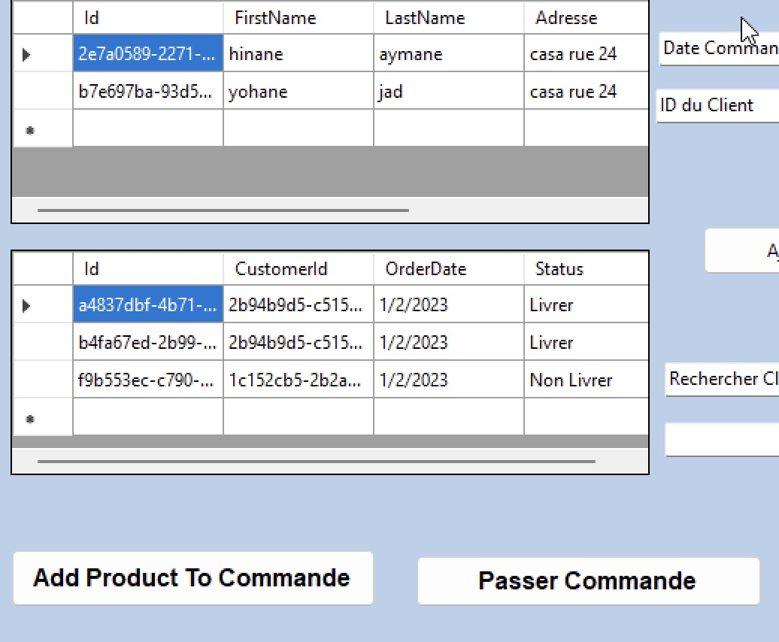
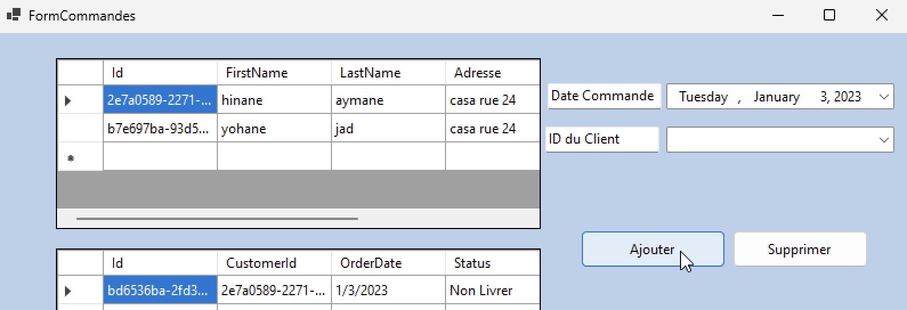
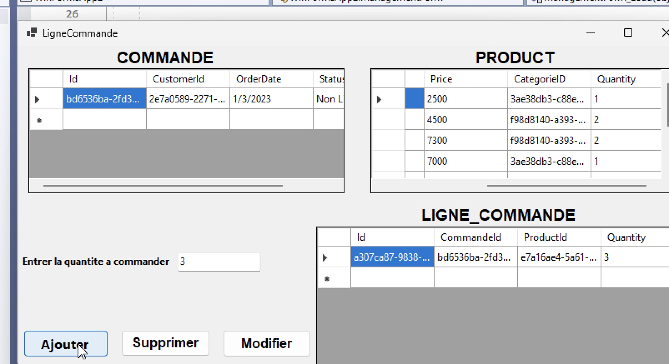
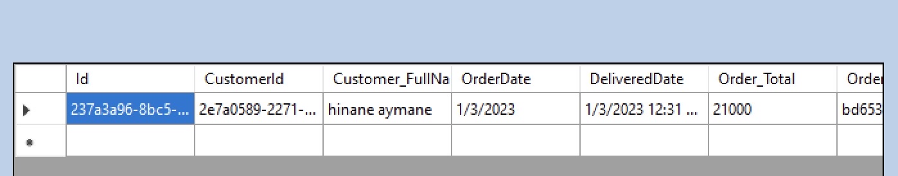
Passer une Commande
public void PasserCommande(string CommandeId)
{
string sql = $"EXECUTE dbo.CreateFacture '{CommandeId}'";
this.OpenConnection();
SqlDataAdapter da = new SqlDataAdapter();
da.UpdateCommand = new SqlCommand(sql, connection);
da.UpdateCommand.ExecuteNonQuery();
this.CloseConnection();
}

Slide 18
Merci Pour Votre Attention

